Slide 1
Employee’s Performance from Data Analyst Perspective
Presenting by:
    Sanjay Uppala
    Meher Rani Pusarla
    Murali Krishna Gurijala
    Vamsi Eragandhula
    Tharun kumar Reddy Male

Slide 2
Employee’s Performance for HR Analytics
Source : Kaggle (https://www.kaggle.com/datasets/sanjanchaudhari/employees-performance-for-hr-analytics)
Problem Statement :Organizations today face a significant challenge in effectively assessing and predicting employee performance.
The project's aim is to utilize employers data to identify the key performance indicators and building a predictive model that can inform strategic HR decisions and foster a culture of continuous improvement and engagement within the organization.
Objective: To develop a statistical model that clarifies the relationship between employee training and performance and forecasts future trends to support HR decision-making for Employee performance.

Slide 3
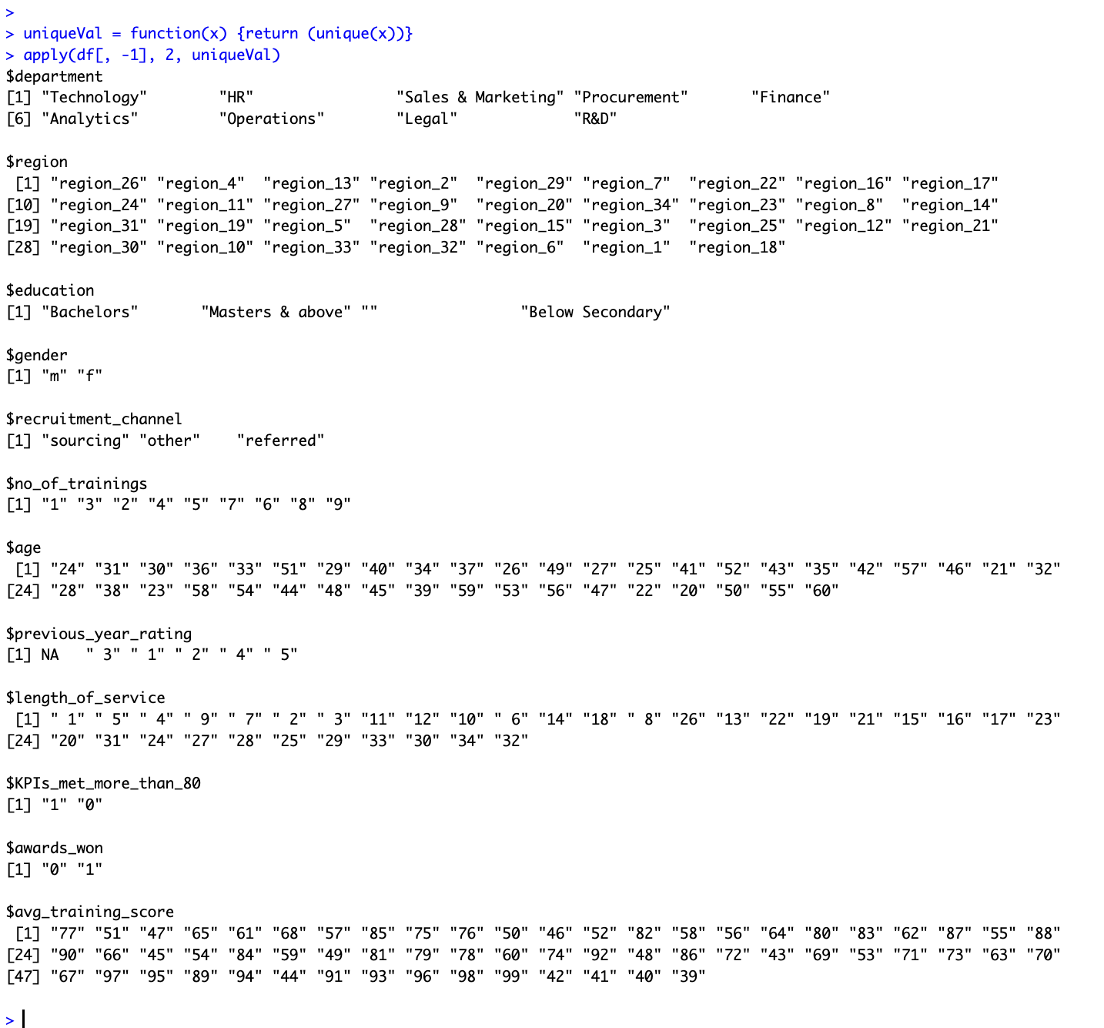
Understanding Data Set

Slide 4
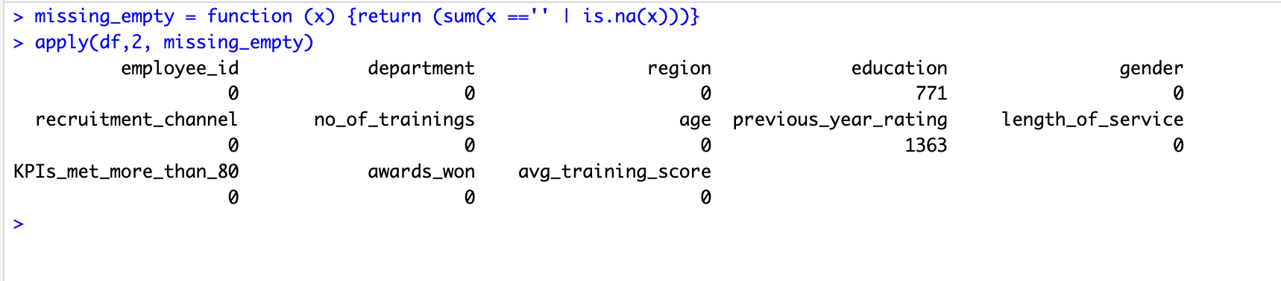
Data Cleaning and Preprocessing:
Data Cleaning and Preprocessing include the following steps:
Total number of missing and blank values were identified for each column
Details of the rows with missing values in previous_year_rating were explored
  All the employers with length of experience less than 1 has NULL value in previous_year_rating
All null values in previous_year_rating column were replaced with value 0.
Details of the rows with blank values in education were explored
All rows with blank value in education column were removed from the entire dataset.

Slide 5
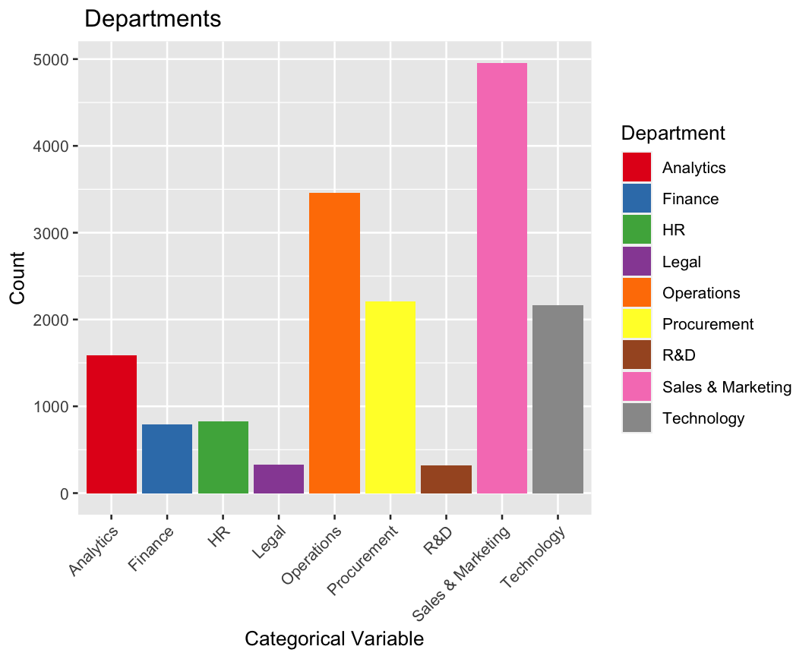
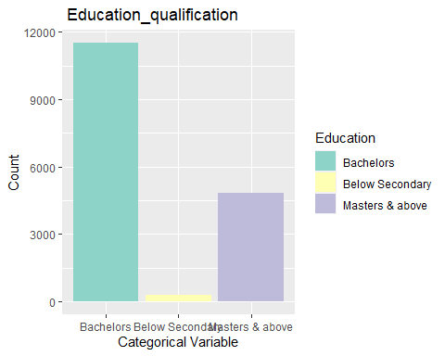
Distribution of Categorical Varibles

Slide 6
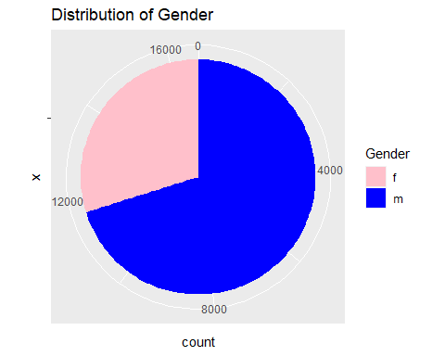
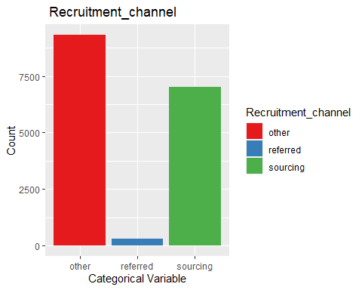

Slide 7
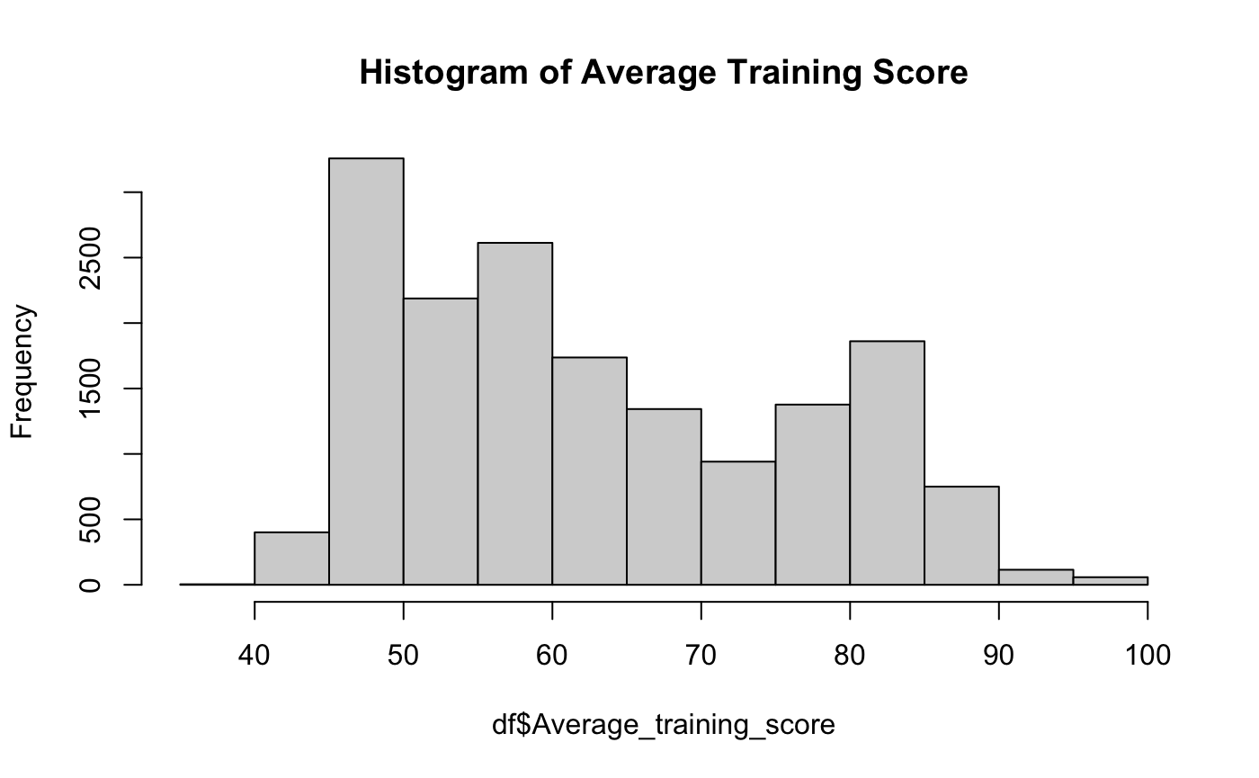
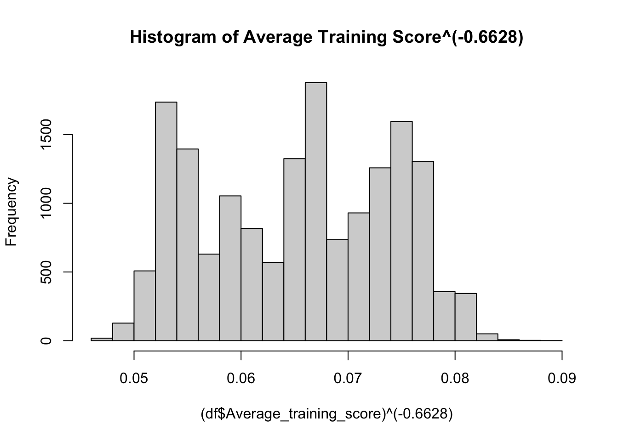
Distribution of Average_training_score
Before Transformation:
After Transformation:

Slide 8
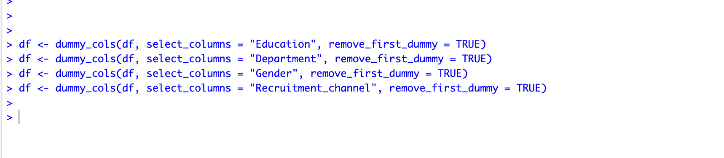
Dummy Variables
Converted categorical variables into numerical variables using dummy variables.
Analytics as baseline for department.
Bachelors as baseline for education.
Female as baseline for gender.
Other as baseline for recruitment channel.

Slide 9
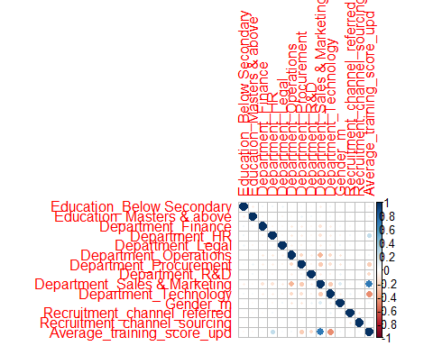
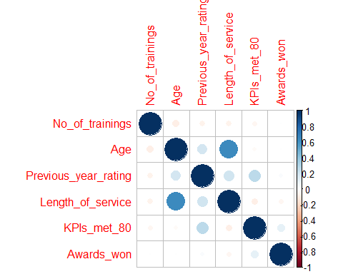
Correlation Analysis :
Correlogram for Numerical Variables
Correlogram for Dummy Variables

Slide 10
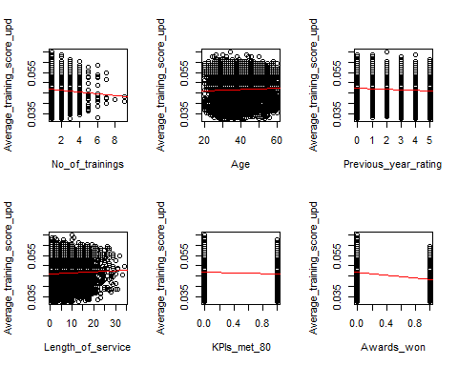
Scatter Plots Distribution:

Slide 11
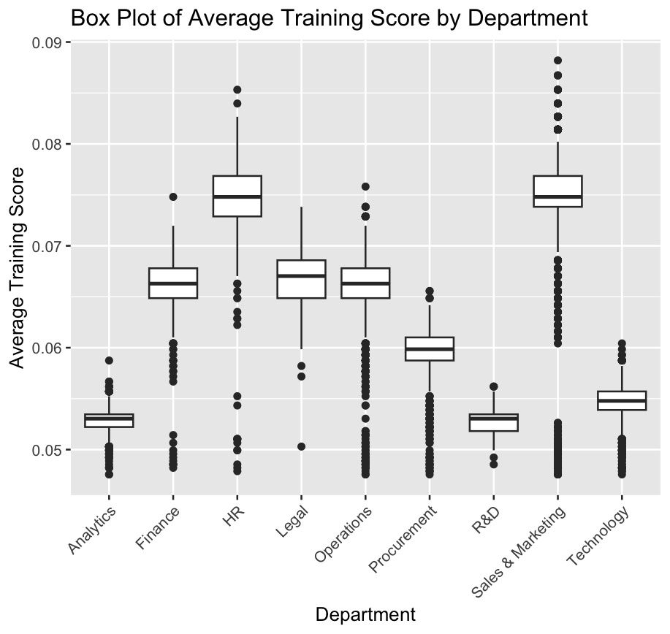
Insights from Boxplot Analysis: Distribution and Variability of Employee Performance Scores

Slide 12
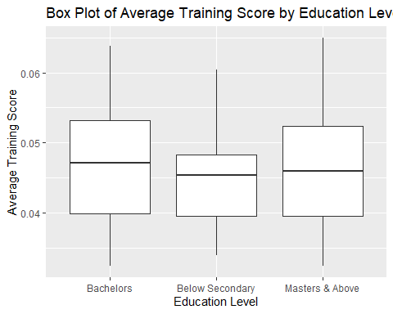
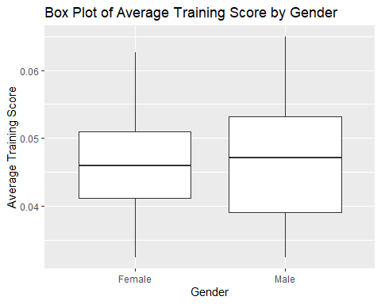
Distribution through boxplots for Education and Gender

Slide 13
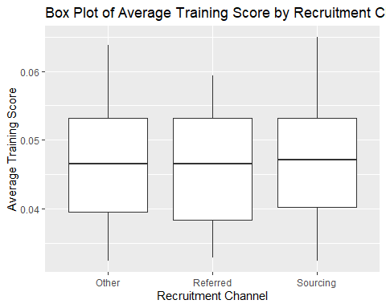
Distribution through boxplots for Recruitment Channel

Slide 14
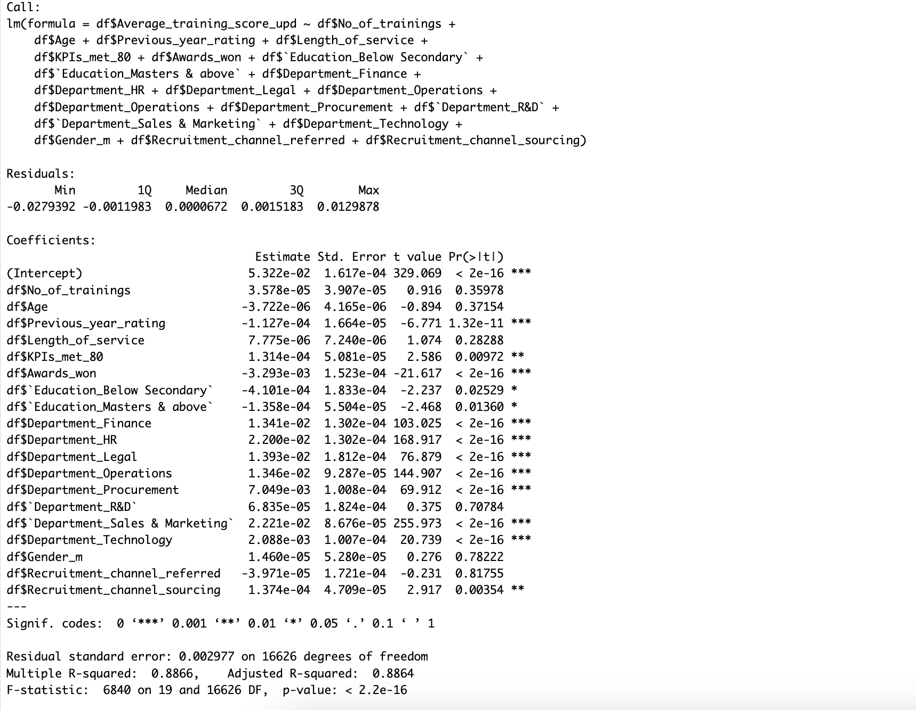
Regression Model
There is no Multi Collinearity

Slide 15
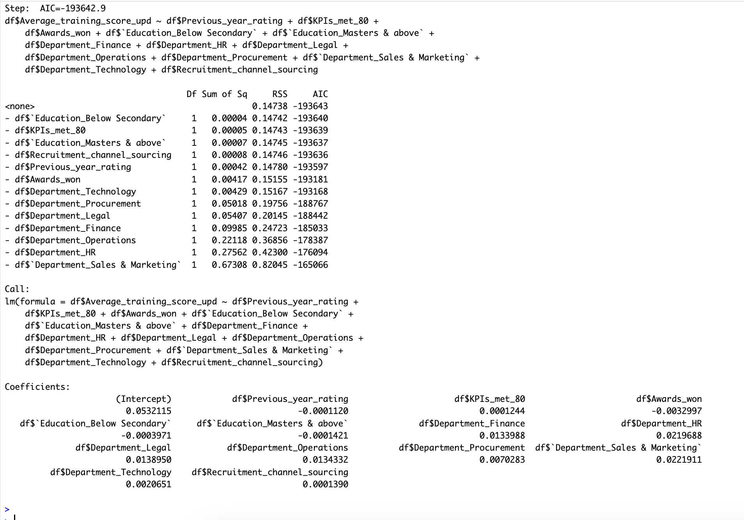
Model Selection using
Backword
Variables that are not significant
->No of Trainings
->Age
->Length Of Service
-> Department _ R&D
->Gender_Male
->RecritumentChannel_reffered

Slide 16
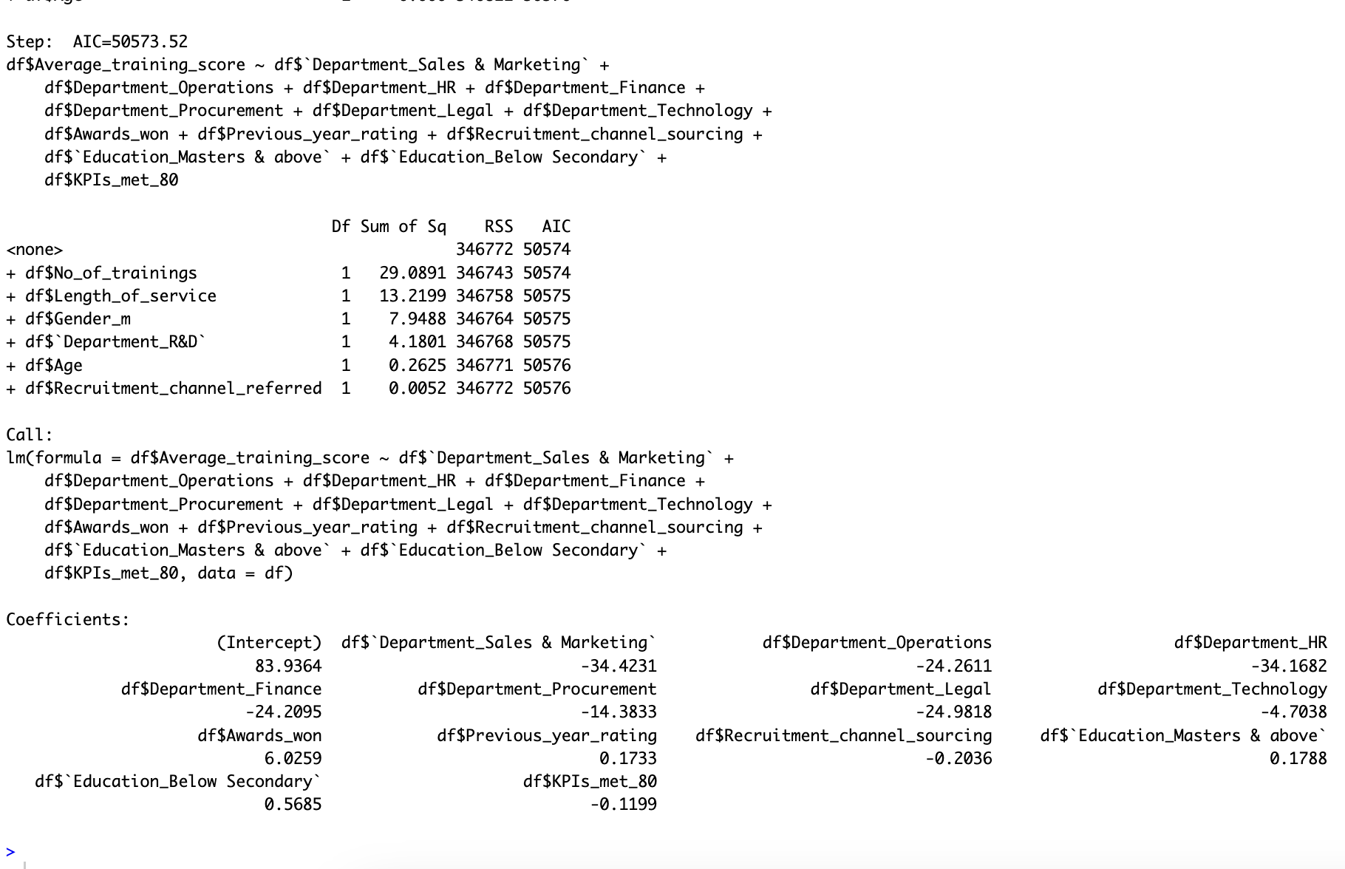
Model Selection using
Forward
Variables that are not significant
->No of Trainings
->Age
->Length Of Service
-> Department _ R&D
->Gender_Male
->RecritumentChannel_reffered

Slide 17
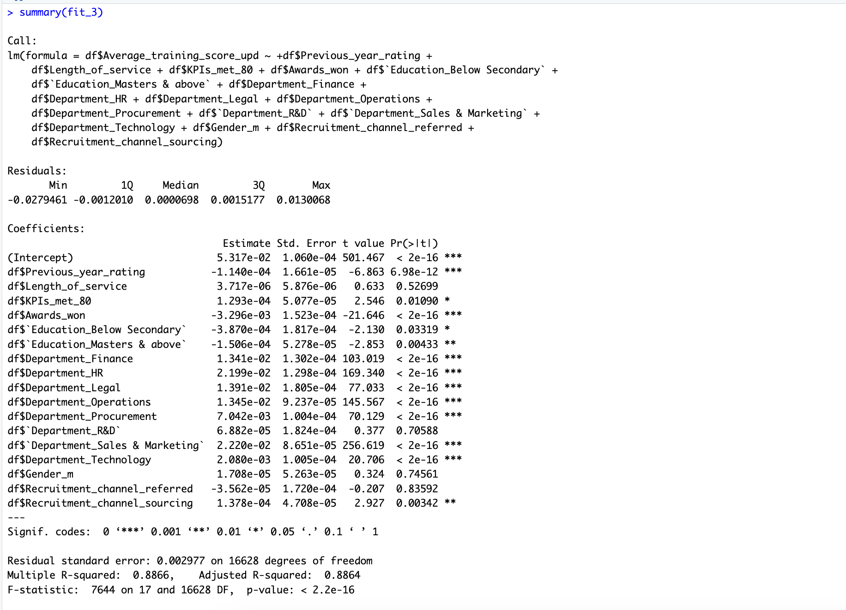
Model Selected Cp and
R-Square
Variables that are not significant
->No of Trainings
->Age

Slide 18
Model for Average_training_score:
Based on the characteristics like number of variables, Model fit statistics which include Adjusted R Square, AIC Values, We have selected forward selection model which is:
fit2 = lm(formula = df$Average_training_score_upd ~ df$Previous_year_rating + df$KPIs_met_80 + df$Awards_won + df$`Education_Below Secondary` + df$`Education_Masters & above` + df$Department_Finance + df$Department_HR + df$Department_Legal + df$Department_Operations +df$Department_Procurement + df$`Department_Sales & Marketing` + df$Department_Technology + df$Recruitment_channel_sourcing)
By the Forward Selection, we observed that,
The adjusted R square value is 0.886
All the variables have less than the p-value 0.05

Slide 19
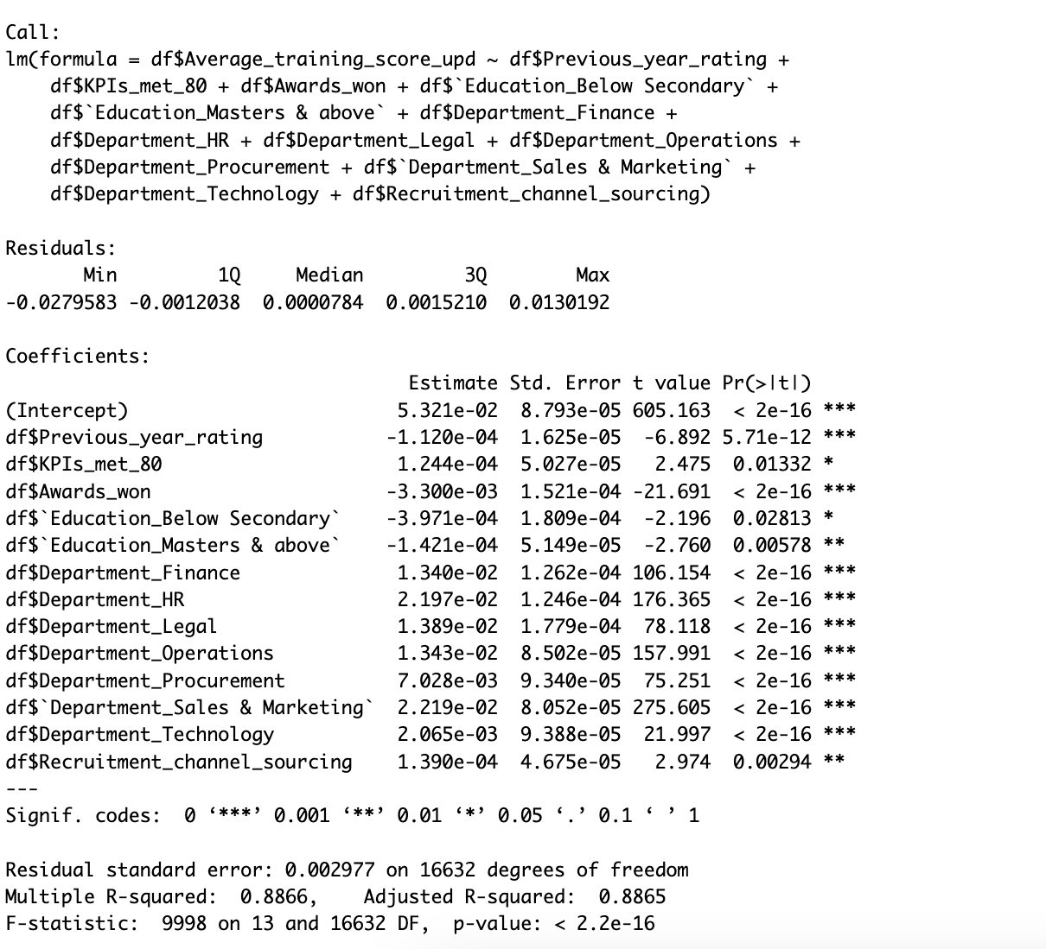
Final Model
Average_training_score_upd = 0.05321 –
0.000112 * Previous_year_rating +
0.000124 * KPIs_met_80 –
0.0033 * Awards_won –
0.0003971 * Education_Below Secondary -
0.0001421 * Education_Masters & above +
0.0134 * Department_Finance +
0.02197 * Department_HR +
0.01389 * Department_Legal +
0.01343 * Department_Operations +
0.007028 * Department_Procurement +
0.02219 * Department_Sales & Marketing +
0.002065 * Department_Technology +
0.000139 * Recruitment_channel_sourcing

Slide 20
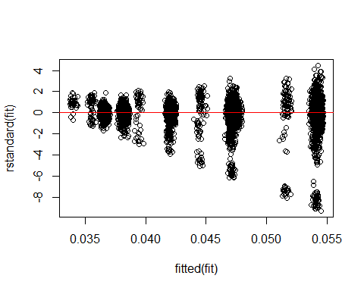
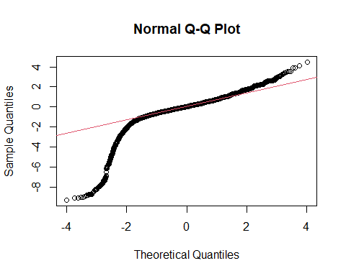
Residual results for the fit model

Slide 21
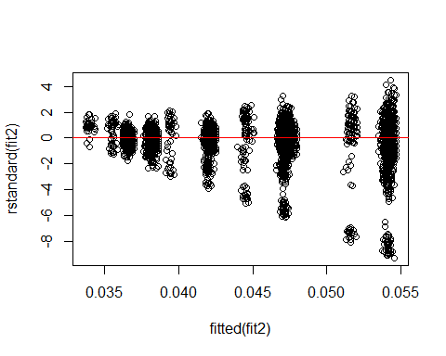

Residual Results for selected model

Slide 22
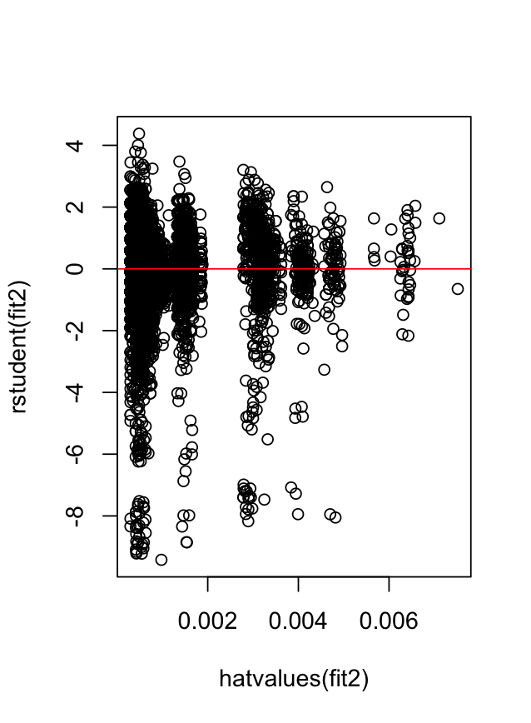
Influential Points and Outliers

Slide 23
Goodness Fit
R2 = 0.8865
Model explains 88.6% variability of Employers Performance.
Goodness of fit test: look at the F-score, get the p-value and compare to alpha = 0.05
  Ho = none of the predictors have effect on Employers Performance.
  Ha = at least one of the predictors has effect on Employers Performance.
  F-score =9998, p-value = 2.2e-16 < 0.05
  Therefore, reject Ho and accept Ha
  Predictive power of the model appears to be good with 88.6%.

Slide 24
Validation & Test data for Model Selection
As we have selected the model, then divide data by
Training set - 75%
Test set -25%
Model is selected using Training data. Test data are used to assess general validity of model to explain new data.
Cross Validation:
Cross-validation is a statistical approach for determining how well the results of a statistical investigation
generalize to a different data set.
It can also determine whether the model fits or not. The process of cross validation include
In 5-fold cross-validation data are split into 5 equal-sized parts.
One part is held out for validation/testing, and a model is fit on the remaining 4 parts.
Predicted values are computed for the validation set

Slide 25
Initial Model
fitt = lm(formula = Average_training_score_upd ~ No_of_trainings + Age + Length_of_service + Previous_year_rating +
KPIs_met_80 + Awards_won + `Education_Below Secondary` +
`Education_Masters & above` + Department_Finance +
Department_HR + Department_Legal + Department_Operations +
Department_Procurement + `Department_R&D` + `Department_Sales & Marketing` +
Department_Technology + Gender_m + Recruitment_channel_referred + Recruitment_channel_sourcing,data=train.myd)
results1 = cv.lm(data=df, form.lm=fitt, m= 5, plotit = F)
head(results1, 5)
rmse_cv <- sqrt((results1$Average_training_score_upd - results1$cvpred)%*%(results1$Average_training_score_upd –
results1$cvpred)/nrow(results1))
> rmse_cv
[1,] 0.002980183

Slide 26
For Final Model
library(DAAG)
fit2t = lm(formula = Average_training_score_upd ~ Previous_year_rating +
KPIs_met_80 + Awards_won + `Education_Below Secondary` +
`Education_Masters & above` + Department_Finance +
Department_HR + Department_Legal + Department_Operations +
Department_Procurement + `Department_Sales & Marketing` +
Department_Technology + Recruitment_channel_sourcing,data=train.myd)
results = cv.lm(data=df, form.lm=fit2t, m= 5, plotit = F)
head(results)
rmse_cv <- sqrt((results$Average_training_score_upd - results$cvpred)%*%(results$Average_training_score_upd
- results$cvpred)/nrow(results))
> rmse_cv
[1,] 0.002979721

Slide 27
Results :
Predicting the results for our selected model
RMSE : 0.002381
MAPE : 3.30406%
MAE :0.001519

Slide 28
Conclusion:
In conclusion, our project demonstrates a highly effective model for predicting Employers' Performance, with an R-squared value of 0.8865, indicating that it explains 88.65% of the variability. Through statistical analysis, we rejected the null hypothesis and accepted the alternative hypothesis as the p value is less than 0.05, affirming the model's predictive power. Additionally, our model was validated using cross-validation techniques, resulting in a low root mean squared error (RMSE) of 0.002381 and high accuracy in predicting Employers' Performance. This comprehensive approach ensures the model's reliability and applicability in real-world scenarios, making it a valuable tool for decision-making.

Slide 29

Thank you

